Slide 1
Introduction to Unit Testing
Jake Marshall & Pragya Paudyal
Data Science Lecturers

Slide 2
Defining Unit Testing
UNIT + TESTING
Unit – small, isolated piece of code (function, method, class etc)
Testing – running code and validate the output works as expected.

Slide 3

What is Unit Testing
Testing an individual unit of code.
Running the unit and checking its output
Confirming the unit operates as intended

Slide 4

Why Unit test
Ensure Code Quality
Detect Bugs Early
Facilitate Refactoring
Improve Maintainability
Enhance Collaboration
Increase Confidence

Slide 5

Unit Tests should
Be small
Be atomic
Test a single functional unit
Be isolated
Return output Fast

Slide 6
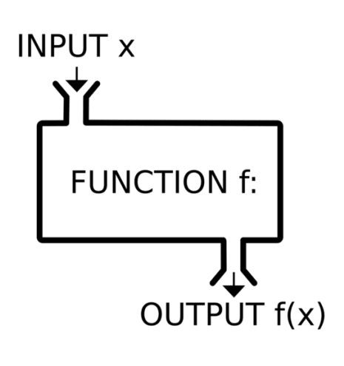
Writing Good Functions
In general, functions should:
Split up tasks in our code – prevents repetition of code, ensures reproducibility.
Not be too small or specific – Single line operations are not worth it.
Not contain entire programs – Difficult to maintain and generalise.
Notes:
Important to understand what the characteristics of good functions are before going on to create unit tests.
Prevents “hard coding” elements
For example, we don’t need a function to add one to an input, this overcomplicates things.
Sometimes two related small steps can be grouped into one “unit”.

Slide 7
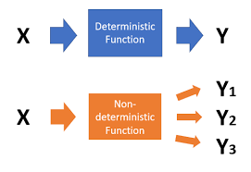
Deterministic Functions
For a given input there is a fixed output.
Think of the mathematical function, for input X, output y and function f, we have the following:
f(X) = y
For the input provided, we should be able to expect the output.
Notes:
If this is not the case, we must limit how it interacts with other parts of our code.

Slide 8
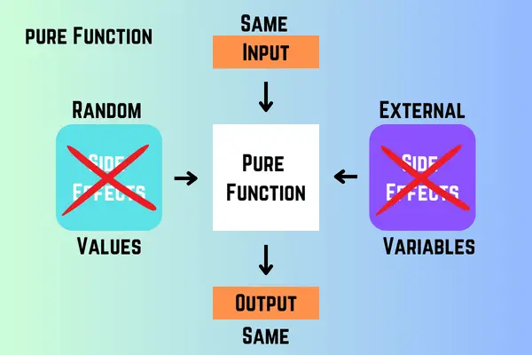
Pure Functions
Deterministic functions that have no side-effects:
Occur when objects in the global scope are used within the function.
External data should be passed to the parameters as inputs:
Ensures that outputs depend only on the inputs.
Notes:
We should be able to determine what the output of our function will be just from reading it.

Slide 9

Side Effects of Impure Functions
Using an external variable without passing as input (through the side):
If not defined, the function fails!
Modifying data inplace:
Re-assign as an arbitrary variable after being input.
Reading or writing to a file – always the possibility of error with paths, access etc.
Notes:
Remember that the local scope of a function is only active when the function is running, once output is generated, the variables created within are cleaned up and removed, never added to the global environment. We even must assign the output of a function call to its own global variable, as you have seen plenty of times.

Slide 10

This is not a binary concept!
A function is not inherently bad if it is not deterministic or pure:
Functions with random elements are not deterministic, but necessary in some cases.
Functions that read and write files are imperative, despite not being pure.

Slide 11

Function Clarity – Naming
What a function does should be clear from its name – underlying body explains how:
Avoid short, generic, non-descriptive names or long, overbearing names.
Avoid conflicting with reserved keywords or function names.
Notes:
Clean, clear and simple functions are easy to understand, maintain and debug.

Slide 12

Function Clarity – Documentation
Functions should contain another layer of documentation, the docstring. This tells the user:
What the function does at a high level.
Arguments it takes and their data types.
What the function returns and its data type.
Side effects raised if impure.
Exceptions raised and why.
Notes:
Our code should be self-documenting, but this is never completely achievable.
Clear commentary should document why you chose a specific approach.
Whenever we use the help functionality on a function, the docstrings are what is returned!

Slide 13

Docstrings
Whenever we use the help functionality on a function, the docstrings are what is returned!
In python we use three double quotes on the line after the function declaration to contain the docstring.
In R, we use the package roxygen2, which allows us to create a multi-line comment which is processed into an R Documentation file.
Notes:
What’s in a name?

Slide 14

Function Clarity – Logic
There is a balance at play between:
Overly descriptive code with redundant elements.
Code simplified at the expense of readability.
Ideally, we should write code that we can come back to after a long break and understand quickly.
Notes:
Grouped according to the task and organising sequentially.

Slide 15
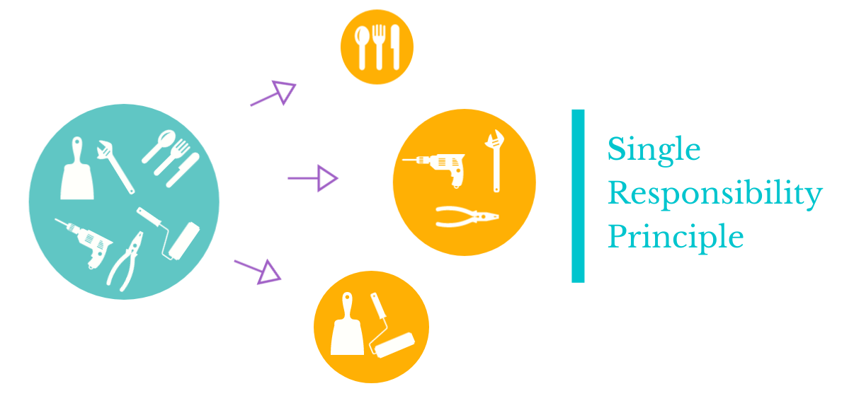
Function Clarity – Appropriate Tasks
Breaking down larger functions into smaller ones assists with:
Clarity
Modularisation
Easier Unit Testing
Component functions can be generalised.
Notes:
Generally, functions should do one task and do it well.
The paradigms are not identical across both languages so it is worth investigating where the grey areas may be across R and python.

Slide 16
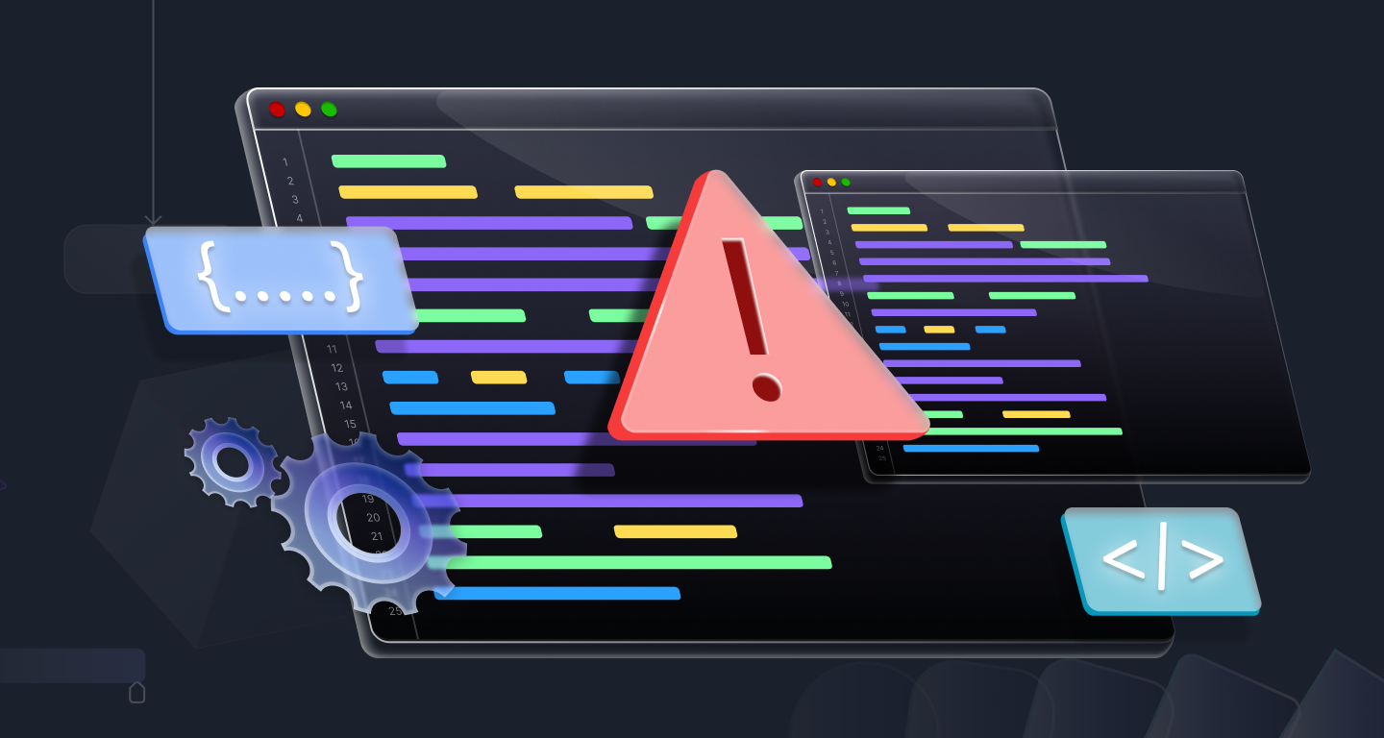
Parameter Validation
Helps alleviate incompatible inputs being passed, checks:
The data type and range of the input.
Check with control flow and raise exceptions for invalid parameters:
Writing our own errors for the function
Should be informative, assist with debugging.

Slide 17
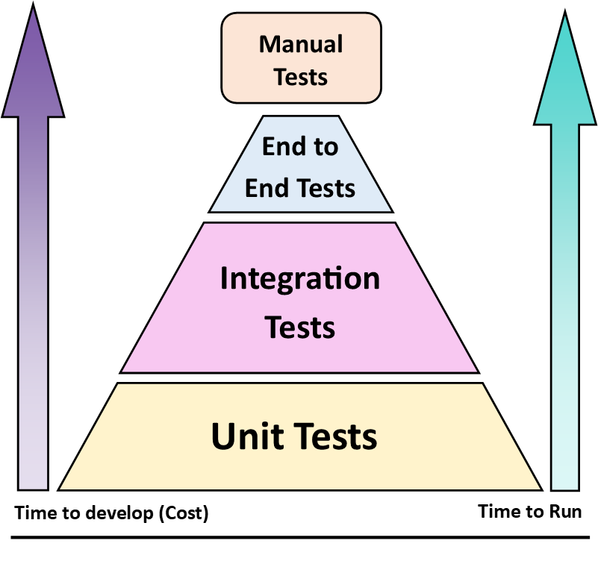
Unit Tests

Slide 18

Questions?

